Slide 1
Automated check Processing
Submitted by
Sivakumar Sankararaman
Jeevantham
Palavi

Slide 2
The Objective
Our understaing of requirements are:
To create an automated check processing which helps to
1. Verify signature
2. Using optical character recognization, converts amount, receiver and automates
data entry in journal
3. Using Machine learning and artifical intelligence, OCR automate clearing process
4. Automatic Data Entry
5. Fraud detection to identify fradulent cheques

Slide 3
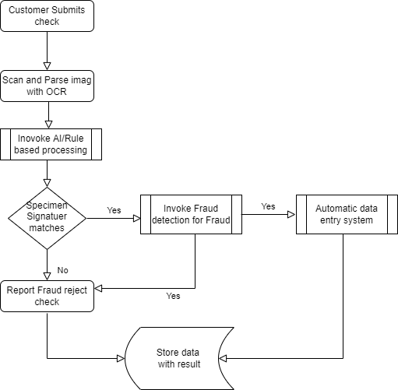
Process Flow
Process Flow diagram depicted in right side takes care of below process flow
Customer submits check
For offline check, scanner scans check and uploads check image to Azure blob
Azure function triggers once new image is uploaded to Azure Blob
Azure function calls OCR along with form recongonizer extracts signature,date, Pay or Bearer name,Account number, IFSC code,Amount
Extracted data is stored in Process folder a temporary blob folder or a storage document db
Same Azure function after getting signature compares with speciment signature of customer and gives score to verify signature
This result will be send to Fraud detection Azure function which analyse based on historic data for fraud
Fraud detection alogirthm will be both rule based such as blocked account, money laundering, hawala fraud as well as
AI based which will be bogus check
Once signature verification and fraud detection checks are passed , processed data will be stored in Staging Datastore for further processing along with verification results
Process Flow diagram

Slide 4
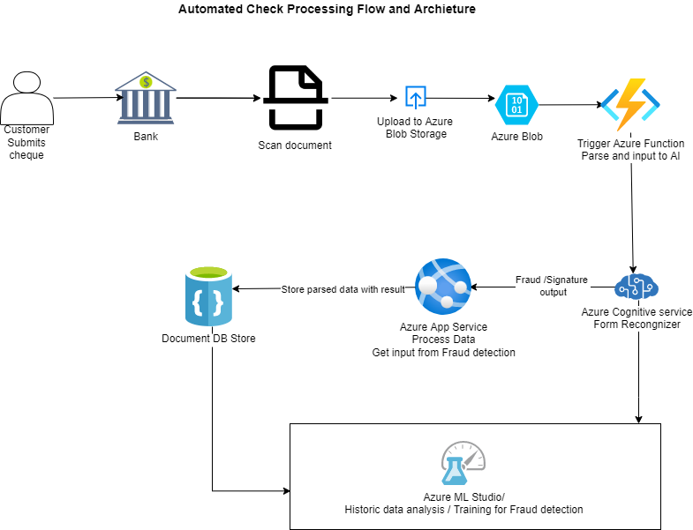
The solution and archeiture

